Slide 1
Image Clustering
Aditya Mulampally
A11816595

Slide 2
Goal of the Project
In this project we are given two mosaic images, which has various textures on it.
We are to use the gabor filter to analyze the feature vectors of each pixel of the image, so as to form the ‘clusters’ on the image.
These clusters that are formed should ideally belong to the textures they originate from.
The image clustering has to be done via two algorithms
K – Means algorithm
EM algorithm

Slide 3
K- Means Algorithm
In this clustering algorithm, we assume start of with the number of clusters we want.
We assume that these clusters centers are known in the image.
We iterate through the entire image and try to allocate each data point to the closest cluster center.
When the above step is done, we compute the new cluster centers by calculating the mean of the classified clusters.
In this way we obtain new centers and try to classify the data points of the entire image in a similar manner.

Slide 4

K-Means algorithm
This objective function is used to calculate the distance between the current mean to the sample data point.
After the initial clusters are computed, I have separated them into different clusters and I have shown a plot according to the clusters obtained.
The average of this matrix has been calculated and then means have been updated.
The main goal of this operation is the minimization of the objective function.
This process converges to the local minimum eventually.

Slide 5
Expectation Maximization Algorithm
The K means algorithm does not consider the spread, structure and the proportion of the different clusters that are formed.
It does not work for the case of non-isotropic feature distributions.
EM solves these problems by addressing these issues.
Here in order to classify the data we compute the probability if data sample y belonging to class x.
We then find the maximum of the hence obtained probabilities in order to estimate the class labels for each cluster.

Slide 6
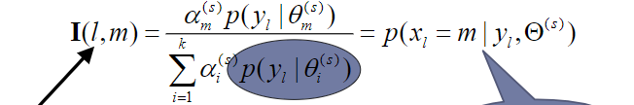
Expectation Maximization Algorithm
The EM method uses the following steps
An initialization step, where the prior probabilities of each cluster is obtained.
We use the best results obtained from K means algorithm in order to refine its classification and also to obtain the prior probabilities of the clusters.
Then comes the Expectation step where by using the initial data we formulate the probabilities of each sample belonging to a specific cluster.
We use this above formula to proceed with the above said calculations

Slide 7
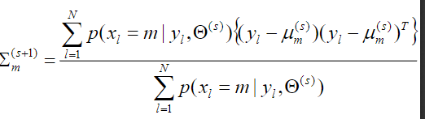

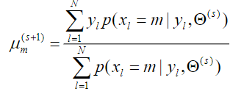
Expectation Maximization Algorithm
This is then followed by the Maximization step, where the class label is found by taking the maximum value of the obtained probability estimate for each cluster label.
We then update the probability, mean and the co-variance matrix to be used again in the expectation step.
We stop this process after a certain number of iterations or till no change in means are obtained.

Slide 8
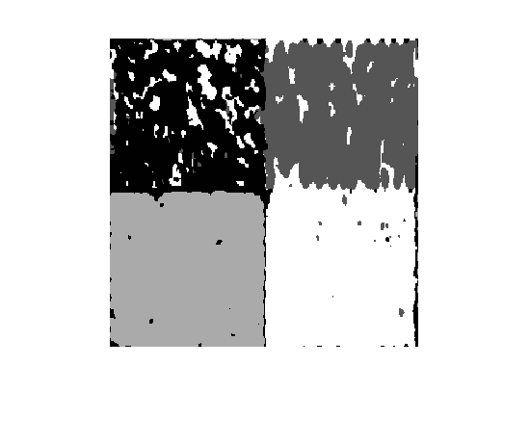
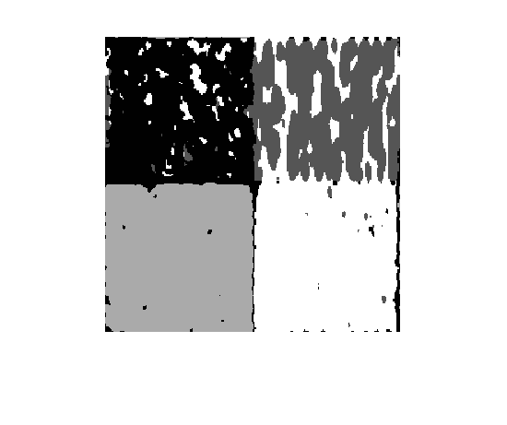
Experimental Results – K means
I had initially set the K means to run for 7 iterations, I can see that the second cluster does not get labelled correctly.
I tried randomizing and changing the initial start locations of the means, but I got the better results by reducing the number of iterations to 5.
I has also tried by normalizing the feature vector matrix, but I had obtained similar results with non normalized feature vectors.
The main issue I have found with K means clustering is the amount of points that it misses for correct classification.
Here K = 4 as we are intending to cluster 4 textures.
5Th Iteration result
7th iteration result

Slide 9
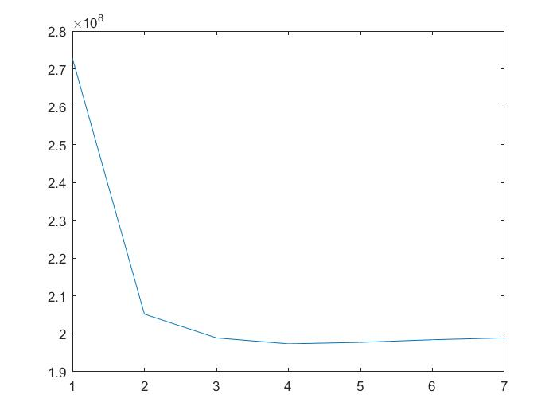
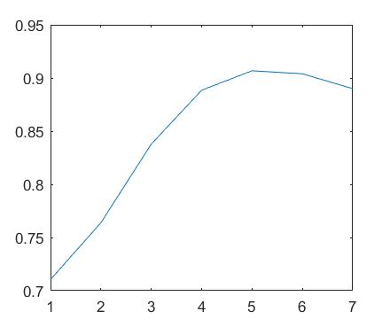
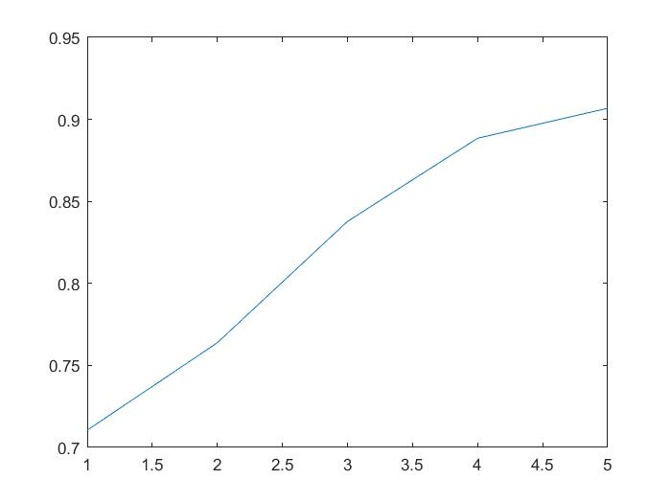
Objective fn vs iteration
Percentage acc vs iteration
Percentage acc vs iteration
The first image is the graph of the objective function vs the iteration number. It can be seen that the algorithm attains a minimum at 5 and then proceeds to increase. For this reason I have chosen my iteration numbers to be 5.
The next graph would be the accuracy percentage. As it follows the trend of graph 1, the accuracy of clustering reduces after 5 iterations.
The 3rd graph is again an accuracy graph, but only plotted till 5 iterations.

Slide 10
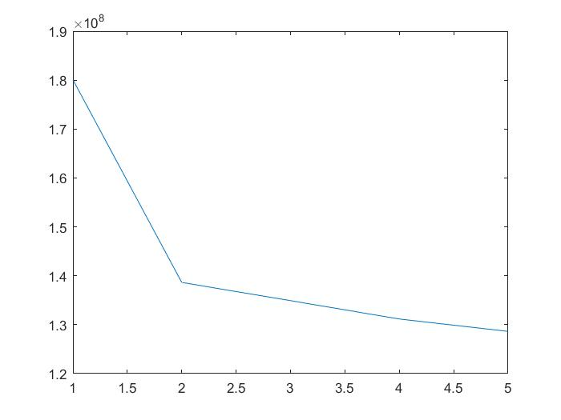
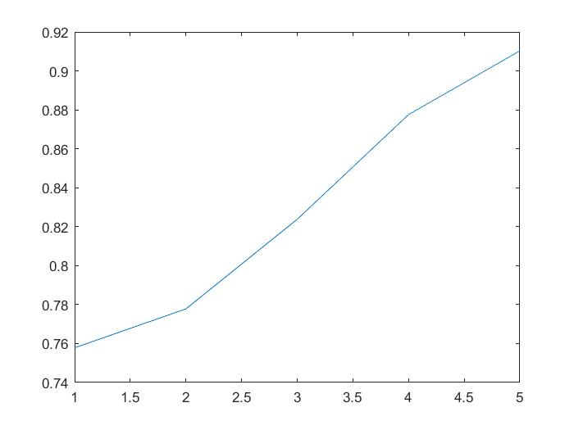
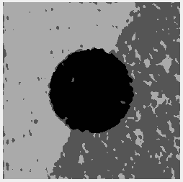
Similar results have been obtained for K means clustering for the second image.
I had found the initialization of the means by randomization and then fixed their positions after obtaining better results.
The second graph is the objective function for 5 iterations
The final graph on the right shows the percentage accuracy vs the iteration.
Objective fn vs iteration
Percentage acc vs iteration

Slide 11
Experimental Results – EM
I have observed that the results obtained via this algorithm gives out considerably better results as obtained via K – means
I can see that from the first iteration of running of the image, the spotty miss-classification that was there from K means goes away.
I have also observed that by the change in the initial means of K means, that are used in turn for EM initialization, causes a significant change in the output obtained.
This algorithm also runs faster as compared to the K means algorithm.

Slide 12
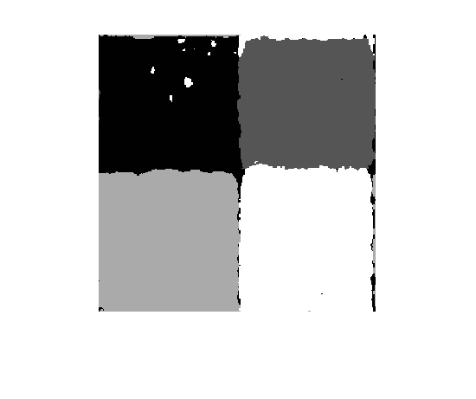
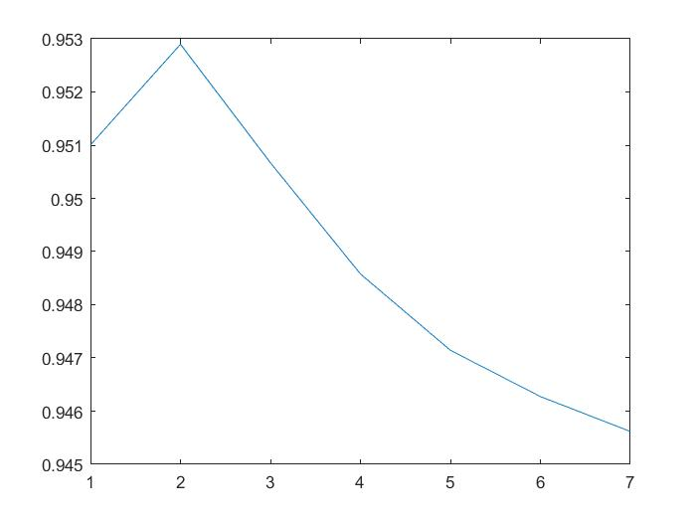
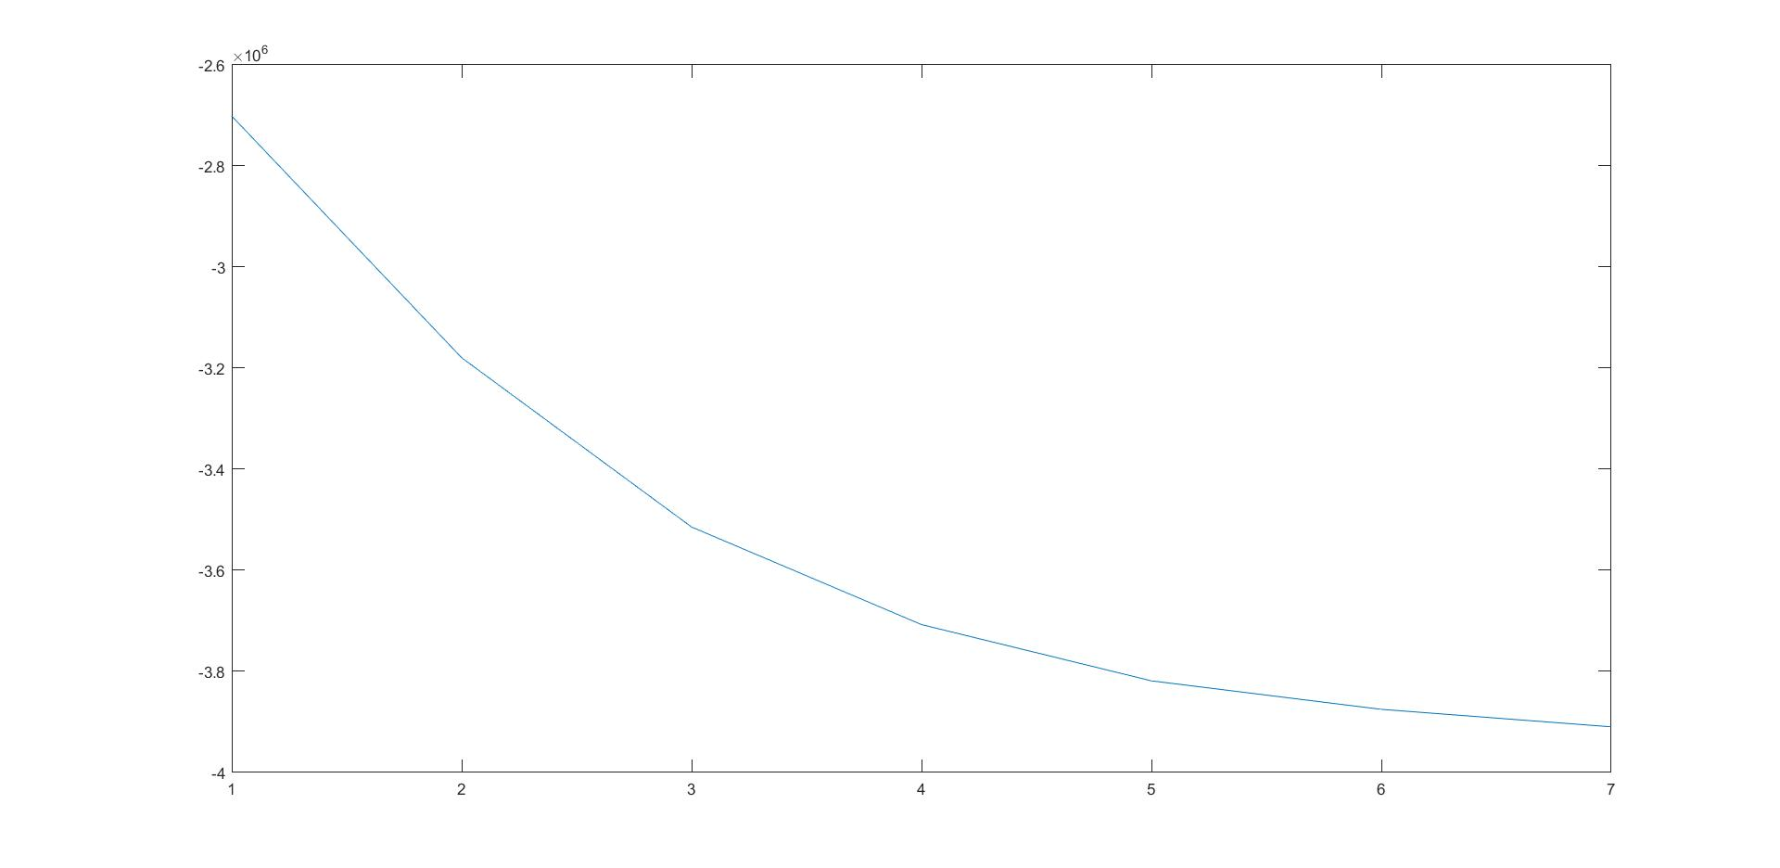
EM- Results – Mosaic A
Percentage acc vs iteration
Log-likely hood vs iteration
From the percentage accuracy graph that I have obtained, I found that I get my best accuracy when iterated 2 times with the EM algorithm
The second graph is the percentage accuracy obtained, by seeing which I have decided that the number of iterations have to be reduced to two.
The third graph is the objective function vs the number of iterations.

Slide 13
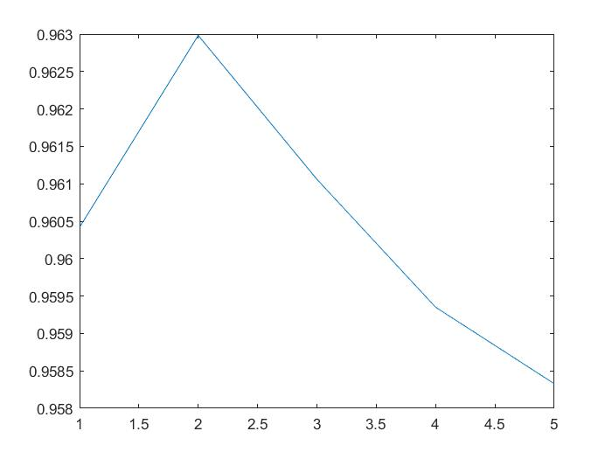
EM Results – Mosaic B
Similar to the first image, for the second mosaic I had run it initially for a duration of 7 iterations.
But from the percentage accuracy graph I had to adjust the iteration count to a range between 2-5 as the percentage accuracy is almost the same
Percentage acc vs iteration

Slide 14
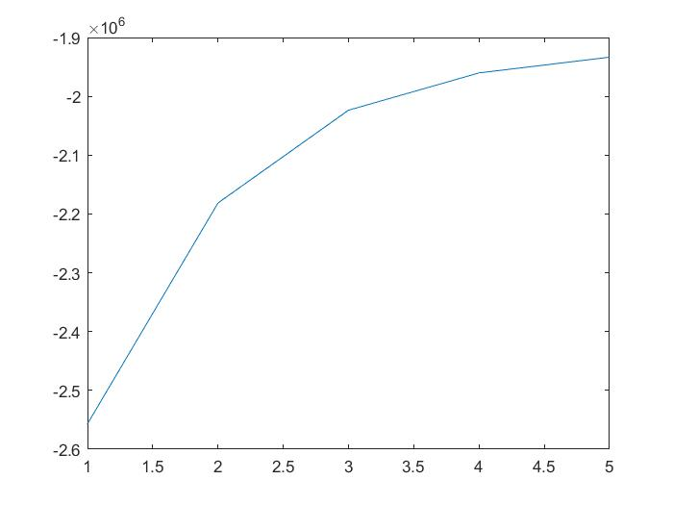
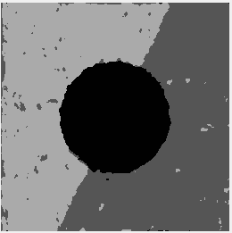
EM Results
Log-likely hood vs iteration
This is the final result I have obtained on the second image with the EM algorithm, as compared to K means, I can see that the clusters are more closer together with less erroneous classification.

Slide 15
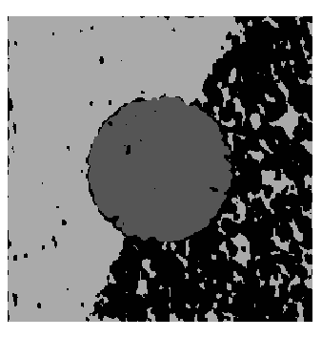
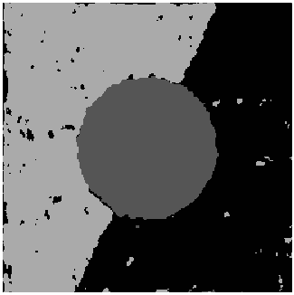
Random Initialization
I have also tried random initialization of the means for the clustering algorithms.
I have observed that at the initial stages of the clustering it identifies wrong clusters, but given enough number of iterations it does converge to give good results.
K means 5 iterations
EM for 6 iterations

Slide 16
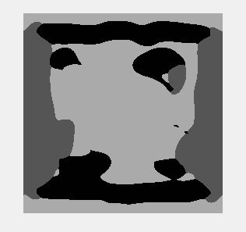


Other Image
I have also tried clustering a colored image, which is the logo of a popular video game.
I have tried using K = 3 for clustering this image as I could see a darker shade of red on the sides of the image.
The first gray image, is the output of 5 iterations of K means clustering
And the bottom image is the output of 7 iterations of EM clustering.
I believe if I give my program more iterations it will cluster in a better manner, but with the results that are obtained we can see that the major outlines and the features of the image are being clustered.

Slide 17
Final Words
I have read that for the proper convergence of the algorithm, we have to see for any changes in the current and the previous result that is obtained and to stop the algorithm when no change occurs.
But I was not able to do that as my program takes almost 16 minutes to complete the complete process, hence I have experimented with different iteration values and selected the best iteration number that has worked for me.
The EM algorithm was harder to implement, but it was worthwhile seeing the better results that it can produce.

